Slide 1

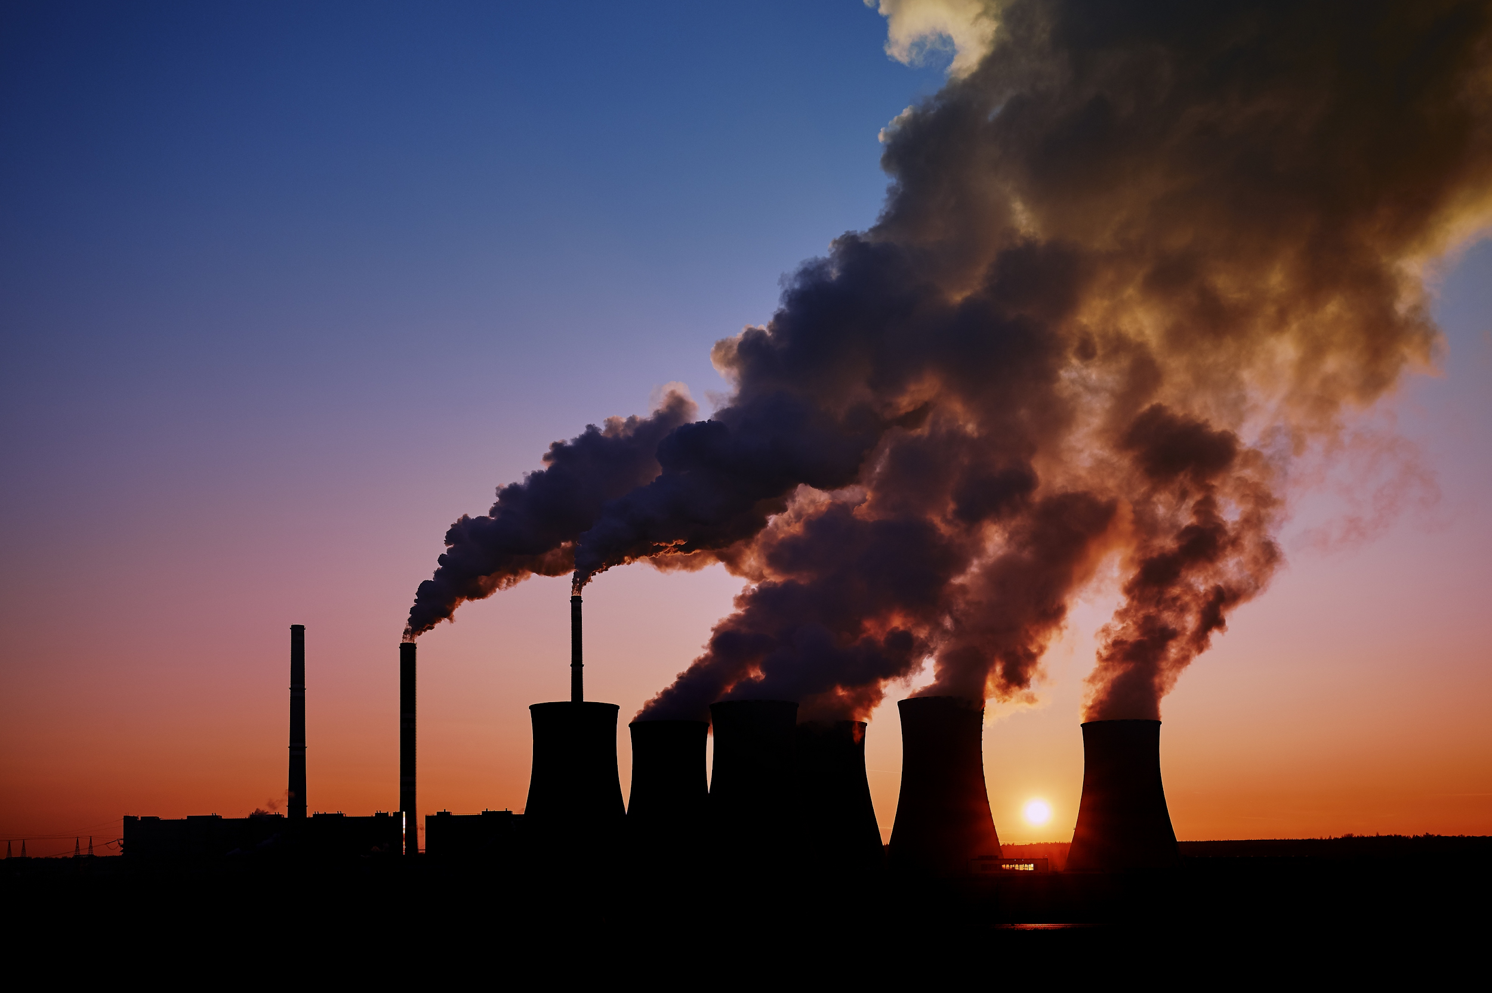
A Global Carbon Market
Analysing the Risk of Potential Changes to Australia’s Carbon Pricing Policy on Schroders’ Investments
Presented By Tricia Garcia, Manon O’Neill, Sherry Fan, Chloe Bi, Erin Shen, Shen Goh
Notes:
The problem we wanted to examine was:
What the risk of carbon prices increasing within integrated carbon emissions trading schemes would do to the profitability of Australian industries, most importantly industries within Schroders portfolios.

Slide 2

Group Profile
Manon O’Neill
Team leader
Tricia Garcia
Project Manager
Sherry Fan
Data Analyst
Chloe Bi
Technology Consultant
Erin Shen
Risk Consultant
Shen Goh
Researcher

Slide 3

AIMS
Qualitatively and quantitatively examine the profitability and experience of sectors from countries that have experienced a rise in carbon prices.
Explore methods to minimise risk for Schroders by examining how companies within emissions trading schemes dealt with these conditions.
Notes:
Our aims were two-fold
We wanted to create a risk assessment that
Qualitatively and quantitatively examined different countries sectors that have experienced a rise in carbon prices.
If we found an effect on investments, we wanted to explore ways to minimise risk for Schroders by examining how companies within emissions trading schemes dealt with these conditions.

Slide 4


Approach and Methodology
AUSTRALIA’S EMISSIONS REDUCTION POLICIES
Carbon Tax (2012-2014)
Emissions Reduction Fund (2016-current)
A GLOBAL CARBON MARKET
The international context
Reasons for linking Australia to a global emissions trading system (ETS)
STUDYING GERMANY’S CARBON MARKET
Impact on industries
Breakpoint mutation test and correlation analysis
Empirical mode decomposition and price prediction
Carbon VaR: E.ON
RECOMMENDATIONS
Implications to Schroders’ investments
Notes:
Looked into Australia’s international obligations, and first establish reasons for Australia linking to a global ETS
Australia’s historical and current emissions reduction policies
Impacts of ETS’s in other countries
Specifically focusing on Germany
Breakpoint mutation test and correlation analysis
Empirical mode decomposition and price prediction
Recommendations

Slide 5
Australia’s Carbon Reduction Policies
Carbon Tax (2012-2014)
Emissions Reduction Fund (2016-Current)
Shareholder wealth in materials, industrial and financial sectors were most negatively affected.
Safeguarded facilities, with scope 1 emissions exceeding 100,000 tonnes CO2-e annually.
140
Return to capital of emission-intensive energy generators decreased by 86%.
0.4%
Projected decline in real GDP as a result of the scheme
Return to capital of renewable energy generators increased by 190%.
Projected amount of reduced CO2 emissions (in megatons) between 2015 and 2020
225

Slide 6
The International Context
Environmental Risk
Financial Risk
Paris Agreement - Article Six
Notes:
Climate Change is beginning to have physical and irreversible impacts on the environment. International agreements, public global outcry, Corporate social responsibility and changing governmental policy are slowly implementing strategies to mitigate climate change. These environmental risks represent externalities that they are not represented within market. Externalities can lead to market failure, therefore the risks needed to be internalise -by charging the polluter the economy enacts the market mechanisms necessary to avoid financial damage. These have manifested in several forms, including emissions trading schemes, carbon taxes and carbon credits, all of which have been implemented in various nations around the globe in their own effort to reduce CO₂ output.
Jump to next slide
As climate change is a global and multidimensional issue requiring international cooperation, the 2015 Paris agreement was established. In article six of the agreement it states nation states should ‘involve the use of internationally transferred mitigation outcomes towards nationally determined contributions. This is inferring the creation of a global emissions trading scheme; discussions about how this would have operated have been circling the United Nations climate change conferences for the past four years. In December last year nation-states again failed to establish a working framework that could be agreed upon.
Although still not internationally agreed upon countries are beginning to integrate their emissions trading schemes.

Slide 7

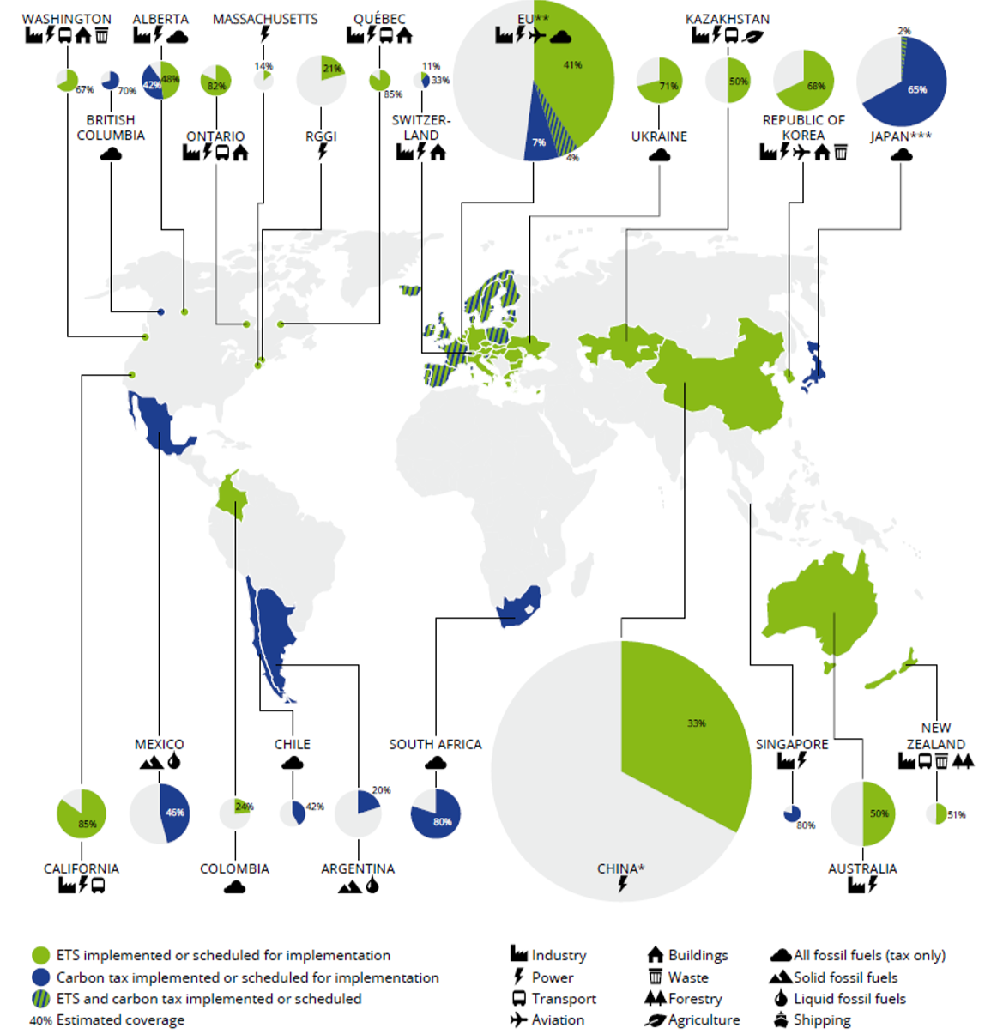
Cross-sectoral emissions trading schemes worldwide
Notes:
This is a map to show the global movement towards carbon schemes, it shows how widespread this movement is across all continents

Slide 8

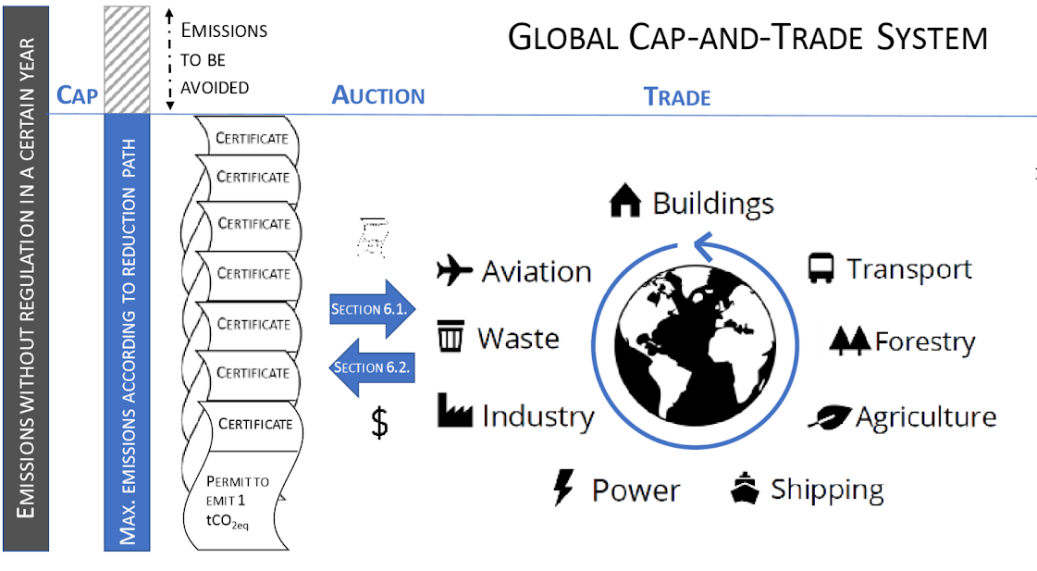
Global Emissions Trading Scheme (ETS)
Enforce compliance by a regulated penalty
Hybrid scheme:
Soft price ceilings and auction reserve price
Auctioned annually worldwide
Notes:
The scope of our project is theorising if Australia joined into an international carbon emissions trading scheme or simply adopted another advanced trading scheme, carbon pricing would ultimately increase due to Australia's current price of 15 dollars which is comparably low.
In a global emissions trading system companies would have a cap on the designated amount of emissions they are allowed to produce. If one's exceeds their designated limit certificates or credits would need to purchased, otherwise they would ensure a penalty.
For a high functioning global ETS that sticks to paris initiatives would need to have soft ceiling pricing method and a reasonable auction reserve price to create a hybrid ETS. These would be necessary to limit the amount of certificates available and allow for a decrease in certificates yearly to foster movement towards low carbon initiatives. These initiatives need to be considered by companies like ones Schroders are invested in, as those that don’t will be left behind the curve. The certificates would be auctioned globally to decrease the chance of rent seeking within countries. This potential market would change the face of Australian sectors opening up a new market that Schroders needs to be aware of.

Slide 9


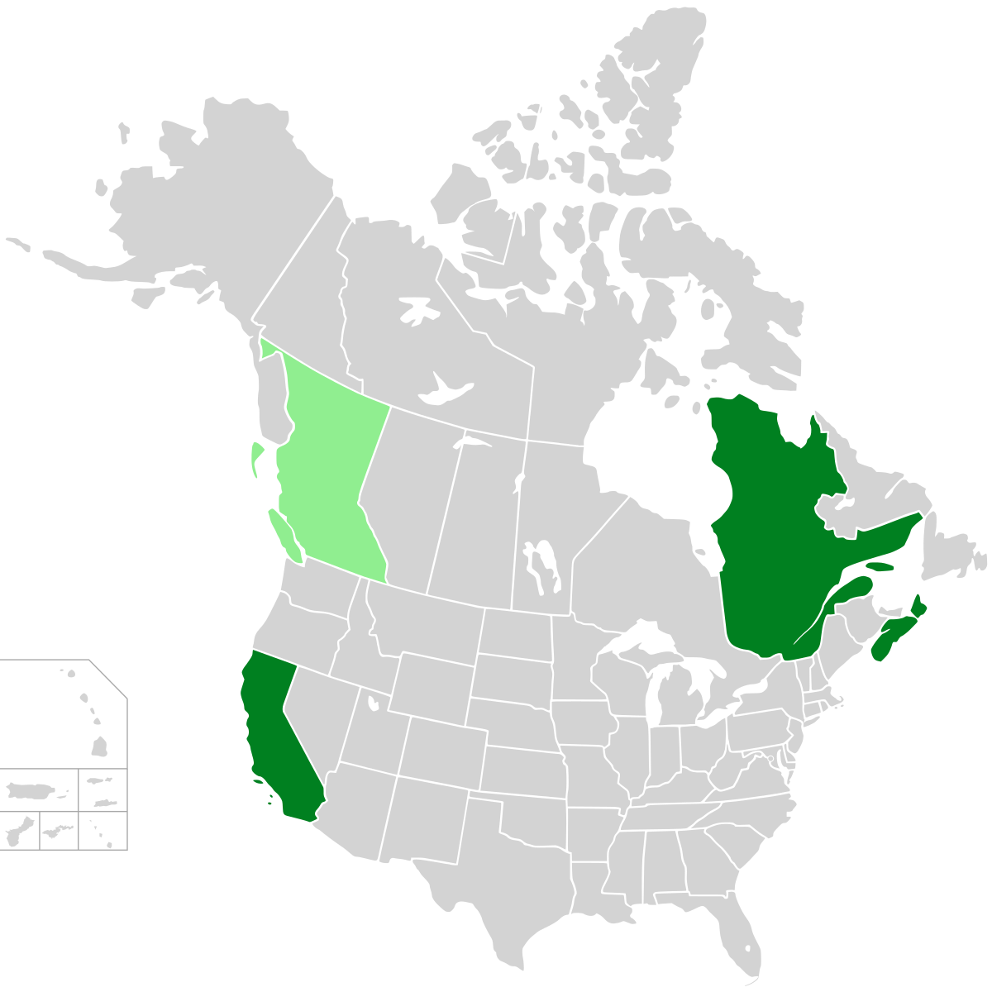
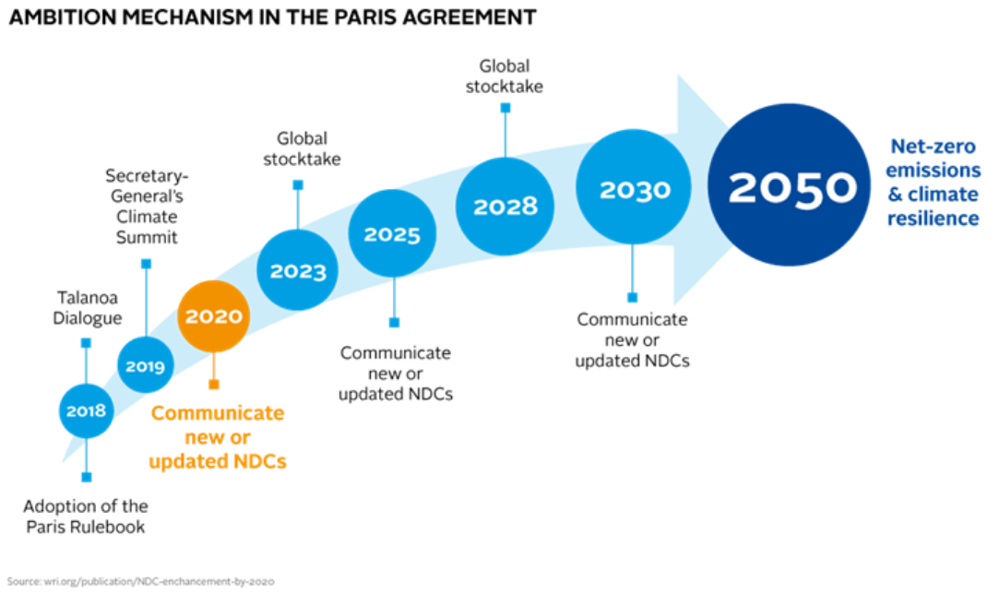
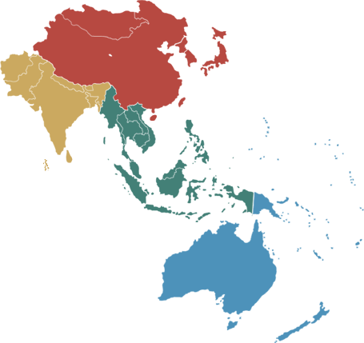
Reasons for a globally-linked Australian ETS
Paris Agreement
China
Linking ETSs
Asia-Pacific Cooperation
Article 6 of 2015 Paris Agreement - method to reduce carbon emissions and prevent global temperatures rising above 1.5oC
Introduction of a national ETS in China - pressure on Australia’s coal exports
Australian ETS would assist in transition away from coal
Regions have already begun to link their ETS systems
Quebec-Canada, Switzerland-EU
Without an ETS, Australia may be left out of a linked ETS system encompassing many countries in the Asia-Pacific region (Vietnam, Thailand, New Zealand, Japan, China)

Slide 10

Impacts of Different ETS Systems
 | Negative Impact | No Impact | Positive Impact
QUEBEC | Employment negatively affected | Mining industry unaffected
NEW ZEALAND | Increased manufacturing costs | Unaffected electricity prices
CHINA | Regional variation on thermal power company performance
EUROPEAN UNION |  | Lithuanian firms unaffected | Increase in labor productivity in Norway

Slide 11



The Case for Germany
Largest Coal Consumer in EU
At the start of Phase III of EU ETS, fossil fuels accounted for more than 80% of energy production
EU’s Largest Economy
GNI per capita around 51,8000 PPP dollars
Part of an International ETS System
Member of the EU ETS since inception in 2005

Slide 12
Schroders Australia Top 10 holdings | Australian Equities Composition | Industry Sector
BHP Group Ltd | 5.40% | Materials
Commonwealth Bank of Australia | 5.10% | Banks
ANZ Banking Group Ltd. | 4.40% | Banks
Rio Tinto Limited | 4.30% | Materials
Woolworths Group Ltd | 4.30% | Consumer Staples
Westpac Banking Corporation | 3.70% | Banks
Telstra Corporation Limited | 3.40% | Telecommunication Services
National Australia Bank Limited | 3.30% | Banks
South32 Ltd. | 3.10% | Materials
Alumina Limited | 2.50% | Materials
Total | 39.50%

Slide 13
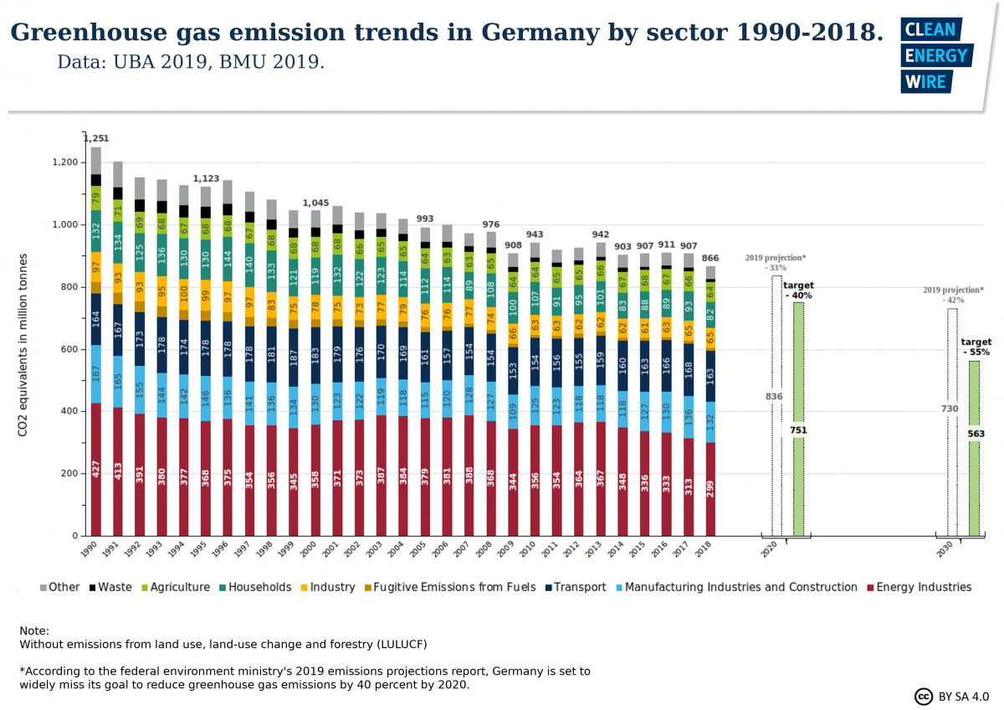
Germany Under the EU ETS
MANUFACTURING
ELECTRICITY

Slide 14
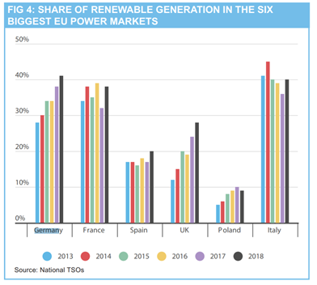
Germany Under the EU ETS
UTILITIES
COMMODITIES

Slide 15
Correlation Analysis between EUA and Industries
5/10/2018
12/13/2018
Structure Break points
 |  | Banks | Basic Resources | Chemical | Financial Services | Industrial | Retail | Technology | Telecom | Utilities
2013- April 2018 | EUA | 0 | 0.4 | 0.6 | 0.5 | 0.4 | 0.5 | 0.5 | 0.5 | 0
May 2018- Dec 2018 |  | -0.3 | -0.6 | -0.6 | 0.4 | -0.4 | -0.5 | -0.6 | 0.3 | -0.1
Jan 2019- Present |  | -0.3 | -0.4 | 0.4 | 0.1 | 0.3 | 0.3 | -0.1 | 0.4 | 0.2
Strong Negative Correlation
Strong Positive Correlation
Notes:
Next, we will assess the carbon price risk in quantitative way. After applying Bai & Perron mutation test to EUA time-series data, we detected two structural break points on May 10th 2018 and December 13th in the same year. The first point happened because of policy changed, and the second one caused by market mechanism.
We apply correlation analysis to these three periods. And we can find the correlation relationship between carbon price and sector price changed throughout these three periods. For correlation matrix, purple means strong negative correlation , while yellow means strong correlation.
In first period, the correlation are all positive, however, in 2nd period, we can see for basic resources, chemicals, industrial, retail and technology, correlation coefficient of these sectors significantly drop down, in the third period, most of these sectors changed back to positive except for basic resources.

Slide 16
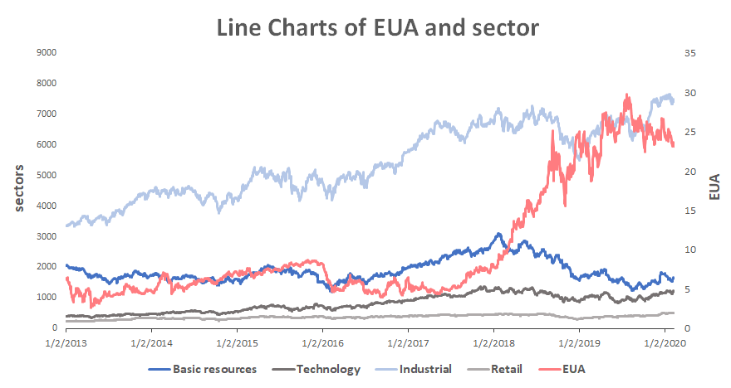
Line Charts of EUA and German Sectors index prices
EUA price rose significantly after 2018 May
After 1-2 months, sectors started to show a decreasing trend
After 18 December, EUA price jumped into fluctuating period, sectors stopped decreasing trend
Carbon price increase will negatively affected market sentiment in related sectors
Source: Bloomberg and investing.com
Notes:
If we look into the line charts in the whole period, we can see carbon price increase significantly after the first breakpoint, and remain a clear increasing trend during the second period. After 1-2 months, sector price reacted to the carbon price movement and started to decrease. When carbon price goes into fluctuating periods again, sector prices stopped decreasing. Hence, we can conclude that: carbon price increase will negatively affect market sentiment in related sectors.

Slide 17
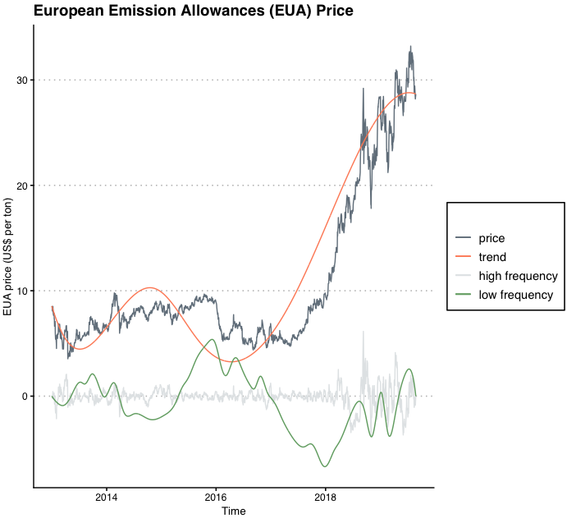
EUA Historical Price Decomposition and Prediction
Notes:
We are going to do carbon price prediction and Carbon VaR for other sectors in Germany, using the historical EUA price, which is the dark line in the plot.
We use math models to decompose the price into different layers.
Have a look of the orange line, this layer indicate the general trend of carbon price.
It decreased in 2015 because there’s too much carbon allowance supply.
And we can observe a sharp Increase since 2018.
At that time, Europe realised there’s too much allowance in the market and they started to reduce their carbon supply

Slide 18
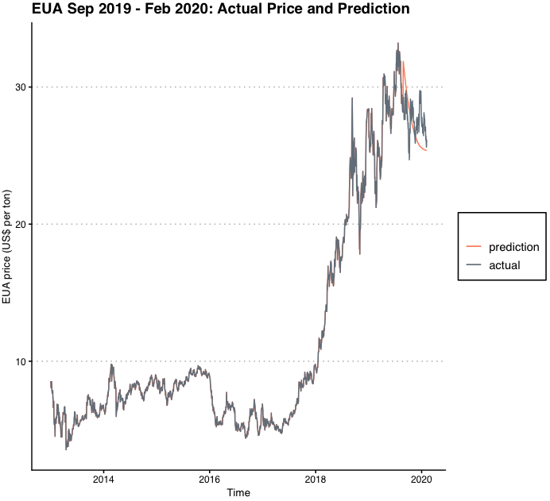
EUA Historical Price Decomposition and Prediction
Notes:
We use math models to do prediction for each layer and add them together to get carbon price prediction
In this plot, orange line is the prediction, dark line is the actual price.
And our model works well

Slide 19
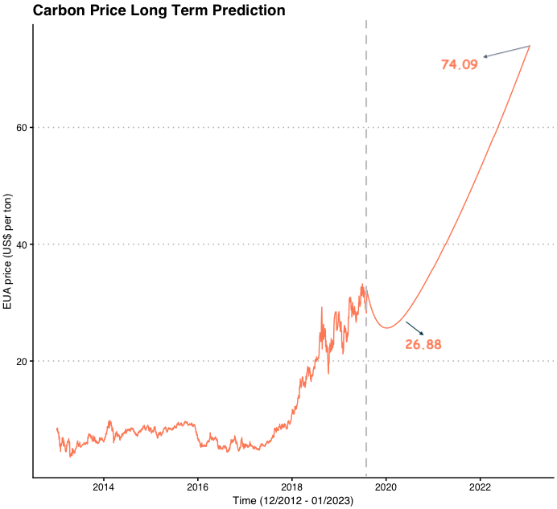
Carbon Prediction: Short Term and Long Term
past
future
Notes:
This is our prediction for the future
In three months, carbon price will drop to 26.8 dollars due to seasonal market fluctuation
And then, it will go up to 74 dollars.
It is a reasonable prediction
As Europe states they will increase the pace of emission cuts from 2020, so we can assume the rapid increasing trend from 2018 will continue.

Slide 20
Carbon VaR E. ON Cost and Profit Approach
Company’s Net Income to Shareholders Prediction
 | Apr 2020 | Jan 2023
CO2 price | $26.88 | $74.09
Emission (2018 consistent) | 69,060,000 t | 69,060,000 t
Cost | $1,856,332,800 | $5,116,655,400
Net income to shareholders | $3,804,929,200 | $554,606,600
Change (based year:2018) | 2.82% | -85.28%
Notes:
This is a traditional method to do carbon VaR. It assumes the only factor can change is carbon price, all other factors will not change.
Higher carbon price in the future means higher cost, which results in lower net income to shareholders.
We use this method to predict the German utilities company, E.ON’s, performance, company’s net income to shareholders will decrease by 85% in three years.
However, the reality is E.ON diverse their energy consumption. Their emission amount will be much lower in 2023.

Slide 21
Carbon VaR Correlation Analysis
Sectors’ Index Prediction
 | Apr 2020 | Change (based:2018) | Jan 2023 | Change (based:2018)
EUA | $26.88 | 6.04% | 74.09 | 192.27%
Basic resources | 1829.21 | -5.34% | -1360.72 | -170.42%
Industrial | 6592.28 | -1.51% | 3458.11 | - 48.34%
Notes:
Now we are going to Carbon VaR using our new method.
We have standardised correlation, we have carbon price prediction. So, we can get sectors index change in the future.
For example, we expect industrial stock index will decrease by 1.5% in the near future, and decrease by 48.3% in three years
But for the basic resources sector, the sector index will be negative in three years, which is impossible.
The reason is we use a consistent correlation in this model. To solve this problem, we can add more data to this model in the future.
So our method is more dynamic than the traditional one.

Slide 22

Recommendations For Schroders
Weighing less on investment towards basic resources and industrial industries
Diversify investments
Foster engagement
Notes:
Based on the qualitative and quantitative analysis, we will be giving out the investment recommendations within carbon intensive sectors.
Portfolio perspective:
From our quantitative analysis, we found that oil price is having negative associations with carbon intensive sectors such as basic resources and industrial after implementing the EU ETS policy, consequently, the costs and profits are affected as well for both short term and long term. Holding our assumptions valid, we would assume the effects of carbon pricing policy will have similar impacts towards those industries. Therefore, we would recommend Schroder weighing less on its investments towards those sectors in the long term when considering ESG factors.
Diversify investments:
Looking at Germany, although utilities industry is carbon intensive sector, the industry is not affected by the carbon price movements. We examined the largest utility companies such as RWE and E.on in Germany, they’ve diversified their operations towards cost efficient renewables while maintaining their coal investments to reduce the carbon effects. Research has found companies will financially perform better with such diversification compared to those who haven’t. Schroders could potentially invest in companies who have also adapted such strategy in Australia within utilities sector in its portfolio.
Foster engagements:
Schroders could engage with Australia’s utility companies and inform them the positive impact of diversification if they haven’t done so while taking ESG risks into account.
Thank you for listening, that’s the end of our presentation.

Slide 23
A Global Carbon Market
A GLOBAL CARBON MARKET
Australia’s international obligations
Reasons for linking to a global emissions trading system (ETS)
AUSTRALIA’S EMISSIONS REDUCTION POLICIES
Carbon Tax (2012-2014)
Emissions Reduction Fund (2016-current)
STUDYING GERMANY’S CARBON MARKET
Impact on industries
Breakpoint mutation test and correlation analysis
Empirical mode decomposition and price prediction
Carbon VaR: E.ON
RECOMMENDATIONS
Implications to Schroders’ investments
Notes:
Thank you for listening, that’s the end of our presentation.

Slide 24
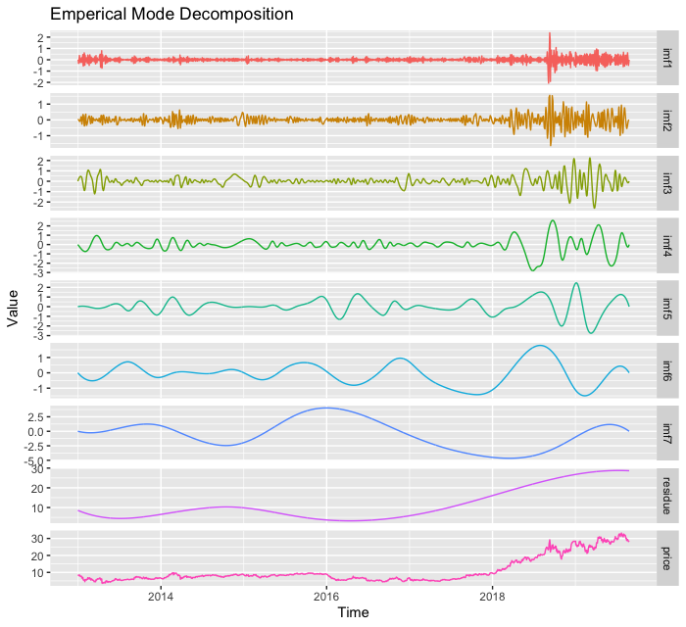
Appendix - EUA Historical Price Decomposition
Empirical Mode Decomposition (EMD)
Decomposing signal into intrinsic mode functions(IMFs) and residuals.
Residual: trend of the dataset.
IMFs: different dimensions which drive the dataset deviate from the trend
Modeling for nonstationary and nonlinear time series data.
Fine-to-coarse Reconstruction
High frequency layer: sum of IMFs whose true mean is not significantly differ from zero.
Low frequency layer: sum of IMFs whose true mean is significantly differ from zero.
Trend: residue

Slide 25
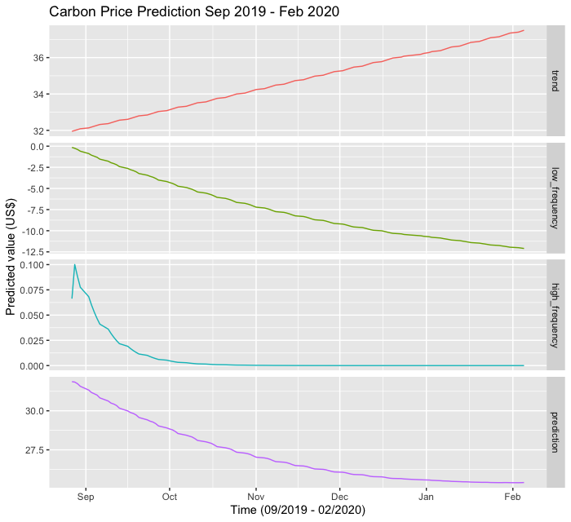
Appendix: EUA Price Prediction
Prediction for each layer
High frequency and low frequency: Autoregressive Integrated Moving Average (ARIMA)
Trend: second degree polynomial regression

Slide 26
Appendix - Carbon VaR: Correlation Analysis
Correlation between standardised EUA and standardised sectors’ index
r = cor(Z_eua, Z_sector)
→ Slope of linear regression (sectors against EUA)
→ Standardised change in sectors
ΔZ_sector = r*ΔZ_eua
→ Change in sectors’ index
Δsector
 | Apr 2020 ($ or index) | Change (based on Dec 2018) | Jan 2023 ($ or index) | Change (based on Dec 2018)
EUA | 26.88 | 6.04% | 74.09 | 192.27%
Basic resources | 1829.21 | -5.34% | -1360.72 | -170.42%
Industrial | 6592.28 | -1.51% | 3458.11 | - 48.34%
Utilities | 799.28 | -0.41% | 698.26 | -12.99%

